Slide 1











Computer PROJECT WORK
NAME :- ARNAB CHATTERJEE
CLASS :- XII-Sc
ROLL :-
PROJECT NAME :- DoCu_iT

Slide 2
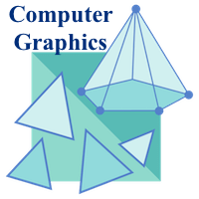
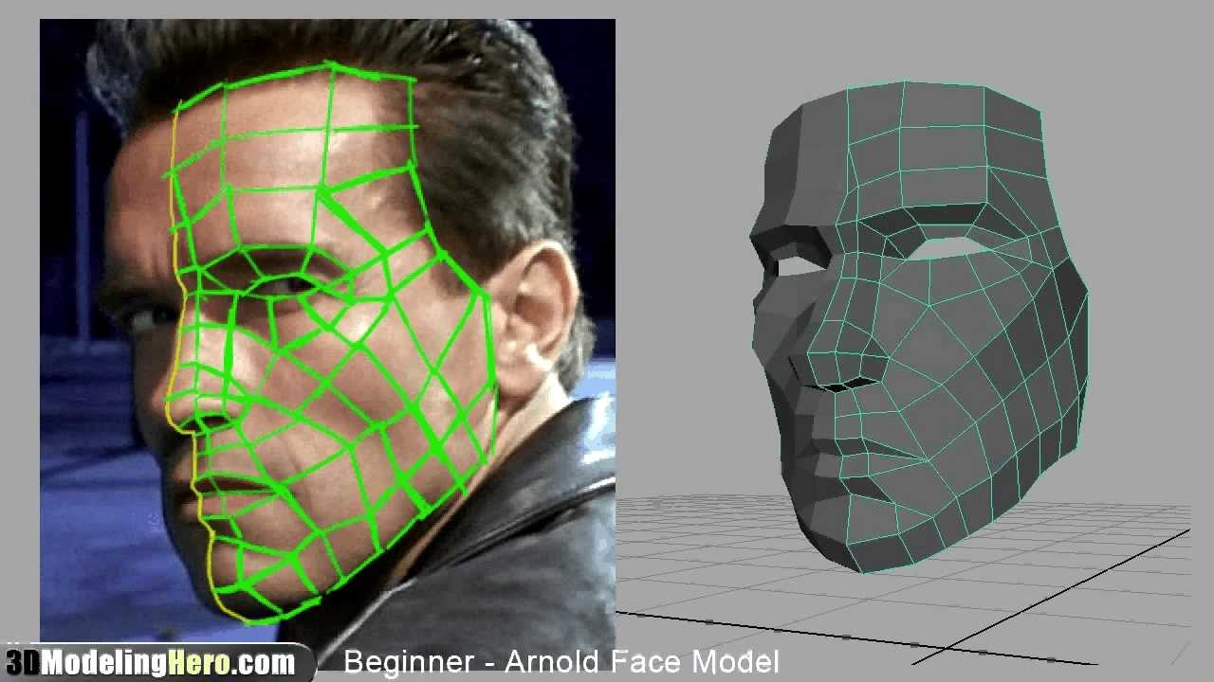
Lets start with a picture.
It is a picture of 3D modelling.
It is a field of Computer graphics.
In this project we will discuss about it
and different filed of it and its application in differnet fileds.

Slide 3
About:
Computer graphics is a sub-field of computer-science which studies methods for digitally synthesizing and manipulating visual content.
It also encompasses 2D graphics and image processing

Slide 4
History:
There are several international conferences and journals where the most significant results in computer graphics are published.
Among them are the SIGGRAPH and Eurographics conferences and the Association of Computing Machinery (ACM) Transactions on Graphics journal.
The joint Eurographics and ACM SIGGRAPH symposium series features the major venues for the more specialized sub-fields: Symposium on Geometry Processing, Symposium on Rendering, Symposium on Computer Animation, and High Performance Graphics.

Slide 5
Subfields:
A broad classification of major subfields in computer graphics might be:
Geometry
ways to represent and process surfaces
Lets discuss the topics in a detailed manner
Animation
ways to represent and manipulate motion
Rendering
Algorithms to reproduce light transport

Slide 6
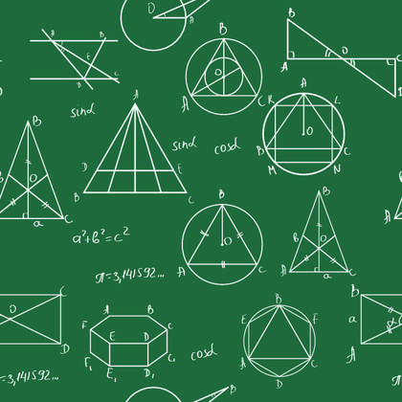
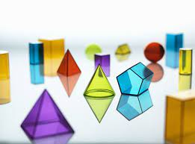
Geometry:
The subfield of geometry studies the representation of three-dimensional objects in a discrete digital setting. Because the appearance of an object depends largely on its exterior, boundary representations are most commonly used.
Two dimensional surfaces are a good representation for most objects, though they may be non-manifold. Since surfaces are not finite, discrete digital approximations are used.
Polygonal meshes are by far the most common representation, although point-based representations have become more popular recently.
These representations are Lagrangian, meaning the spatial locations of the samples are independent. Recently, Eulerian surface descriptions such as llevel sets have been developed into a useful representation for deforming surfaces which undergo many topological.

Slide 7
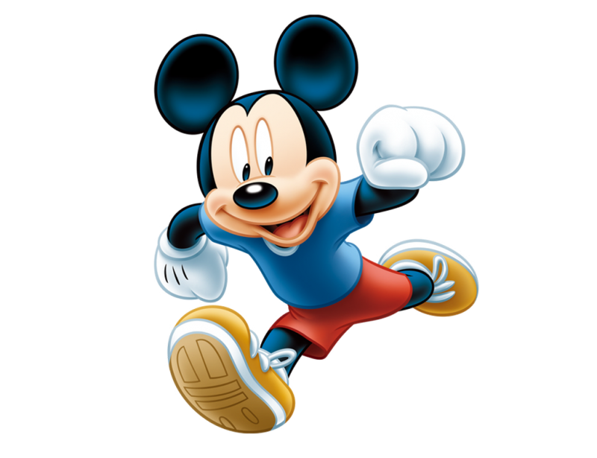
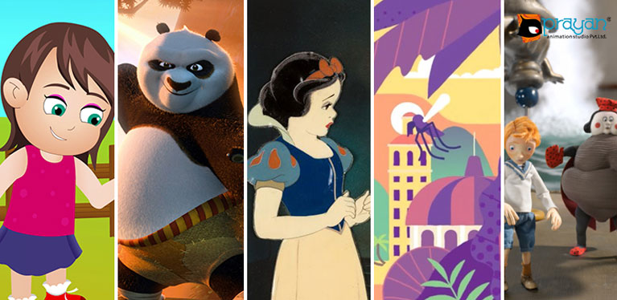
Animation:
The subfield of animation studies descriptions for surfaces (and other phenomena) that move or deform over time.
Historically, most work in this field has focused on parametric and data-driven models.
But recently physical simulation has become more popular as computers have become more powerful computationally.

Slide 8

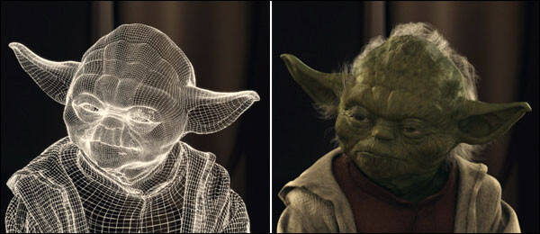
RENDERING:
Rendering generates images from a model.
Rendering may simulate light transport to create realistic images or it may create images that have a particular artistic style in non-photo realistic rendering.
The two basic operations in realistic rendering are:
transport (how much light passes from one place to another)
and
scattering (how surfaces interact with light).

Slide 9
Image types:
2D graphics
2D computer graphics are the computer-based generation of digital images from models, such as digital image, and by techniques specific to them.
2D computer graphics are mainly used in applications that were originally developed upon traditional printing and drawing technologies such as typography.
In those applications, the two-dimensional image is not just a representation of a real-world object, but an independent artifact with added semantic value; two-dimensional models are therefore preferred because they give more direct control of the image than 3D computer graphics, whose approach is more akin to photography than to typography.

Slide 10
3D graphics
3D graphics, compared to 2D graphics, are graphics that use a three dimensional representation of geometric data. For the purpose of performance, this is stored in the computer. This includes images that may be for later display or for real-time viewing.
Despite these differences, 3D computer graphics rely on similar alogorithms as 2D computer graphics do in the frame and raster graphics (like in 2D) in the final rendered display. In computer graphics software, the distinction between 2D and 3D is occasionally blurred; 2D applications may use 3D techniques to achieve effects such as lighting, and primarily 3D may use 2D rendering techniques.
3D computer graphics are the same as 3D models.

Slide 11
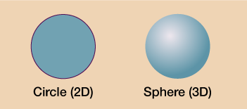
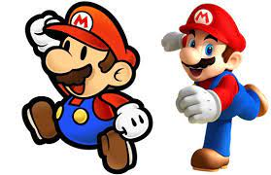
Difference:
Let’s differentiate between 2D and 3D in a pictorial way.
A 2D shape is a shape with two dimensions, such as width and height; a 3D shape is a shape with three dimensions, such as width, height and depth

Slide 12
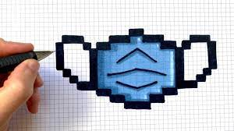

Pixel Art:
A large form of digital art, pixel art is created through the use of raster graphics software, where images are edited on the pixel level.
Graphics in most old (or relatively limited) computer and video games, graphing calculator games, and many mobile phone games are mostly pixel art.
A great example of pixel art are the arcade style retro games.

Slide 13

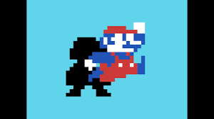
Sprite Graphics:
A sprite is a two-dimensional image or animation that is integrated into a larger scene.
Initially including just graphical objects handled separately from the memory bitmap of a video display, this now includes various manners of graphical overlays.
Originally, sprites were a method of integrating unrelated bitmaps so that they appeared to be part of the normal bitmap on a screen, such as creating an animated character that can be moved on a screen without altering the data defining the overall screen.

Slide 14

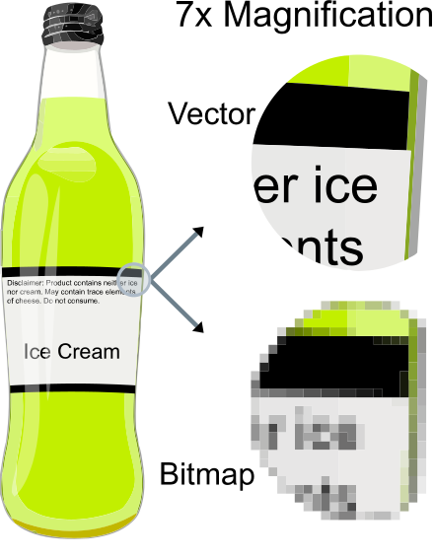
Vector graphics:
Vector graphics consists in encoding information about shapes and colors that comprise the image, which can allow for more flexibility in rendering.
Vector graphics formats are complementary to raster graphics. Raster graphics is the representation of images as an array of pixels and is typically used for the representation of photographic images.
There are instances when working with vector tools and formats is best practice, and instances when working with raster tools and formats is best practice. There are times when both formats come together.

Slide 15
Concepts and Principles………

Slide 16
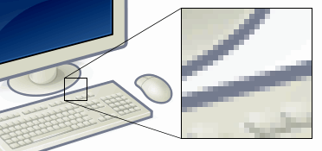
Pixel:
In digital imaging, a pixel (or picture element) is a single point in a raster image.
Pixels are placed on a regular 2-dimensional grid, and are often represented using dots or squares. Each pixel is a sample of an original image, where more samples typically provide a more accurate representation of the original.
The intensity of each pixel is variable; in color systems, each pixel has typically three components such as red, green, and blue.

Slide 17
Primitives:
Primitives are basic units which a graphics system may combine to create more complex images or models.
Examples would be:-
sprites and character maps in 2D video games
geometric primitives in CAD
polygons or triangles in 3D rendering.
Primitives may be supported in hardware for efficient rendering, or the building blocks provided by a graphics application.

Slide 18
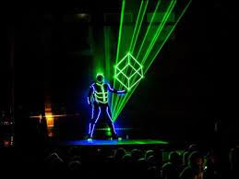
3D Projection:
3D projection is a method of mapping three dimensional points to a two dimensional plane.
As most current methods for displaying graphical data are based on planar two dimensional media, the use of this type of projection is widespread.
This method is used in most real-time 3D applications and typically uses rasterization to produce the final image.

Slide 19
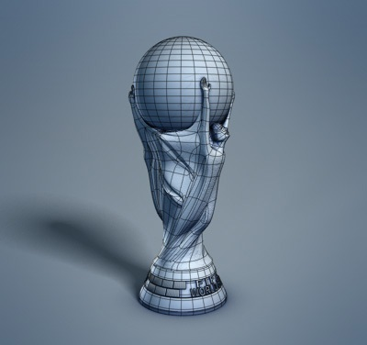
3D Modelling :
3D modeling is the process of developing a mathematical, wireframe representation of any three-dimensional object, called a "3D model", via specialized software. Models may be created automatically or manually; the manual modeling process of preparing geometric data for 3D computer graphics is similar to plastic arts such as sculpting.
3D models may be created using multiple approaches: use of NURBs to generate accurate and smooth surface patches, polygonal mesh modeling or polygonal mesh subdivision.

Slide 20
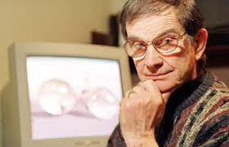
Pioneers:
Charles Csuri
Charles Csuri is a pioneer in computer animation and digital fine art and created the first computer art in 1964.
Csuri was recognized by Smithsonian as the father of digital art and computer animation, and as a pioneer of computer animation by the Museum of Modern Art (MoMA) and Association for Computing Machinery-SIGGRAPH.

Slide 21
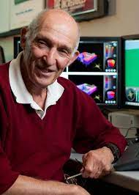
Donald P. Greenberg
Donald P. Greenberg is a leading innovator in computer graphics. Greenberg has authored hundreds of articles and served as a teacher and mentor to many prominent computer graphic artists, animators, and researchers such as Robert L. Cook, Marc Levoy, Brian A. Barsky, and Wayne Lytle. Many of his former students have won Academy Awards for technical achievements and several have won the SIGGRAPHAchievement Award. Greenberg was the founding director of the NSF Center for Computer Graphics and Scientific Visualization.

Slide 22

Thank You
The project is prepared
Arnab Chatterjee
XI Sc.
Of DAV Pandaveswar

